Slide 1
Design Science Research
Advanced Practical Course – Next Generation Data Center Operations for SAP Enterprise Software (IN2128, IN2106, IN212810)
Simon Fuchs, Maximilian Niedermeier, Noah Kim, Leon Kist
4 May, 2026

Slide 2
Agenda
Design Science Research
What is Design Science Research?
Hevner’s Guidelines for Design
Design Science Project Cycle

Slide 3
What is Design Science Research?

Slide 4
Design Science Research
What is Design Science Research?
Design Science Research (DSR) is
Notes:
4

Slide 5
Early 2000s – Information Systems is forming
What is Design Science Research?
Anglo-American World
IS is formed by economics researches realizing that IT has drastic impact on economy and its own logic
Focuses on social theories and methodologies to research IT-related economic research questions
Desciptive
“There should be a tool to allow intuitive, visual and instinctive screen control”
Problem: Never constructs solutions, only analyzes
German-speaking World
„Wirtschaftsinformatik“ is formed by Computer Science people realising that IT has drastic economic potential which infulences and shapes Computer Science developments
Prototype- and development-focus
Designing (pragmatic)
„I have constructed someting that I call mouse. Isn‘t it great?“
Problem: Only constructs, never analyzes
Notes:
5

Slide 6

Alan Hevner‘s Synthesis
What is Design Science Research?
We argue, along with behavioral IS researchers (Applegate 1999), that
it is possible and necessary for all IS research paradigms to be both rigorous and relevant.
In Hevner, A.R., et al., Design science in information systems research. MIS Q., 2004. 28(1): p. 75–105.
https://scholar.google.com/citations?user=j9NDJ_wAAAAJ&hl=en

Slide 7
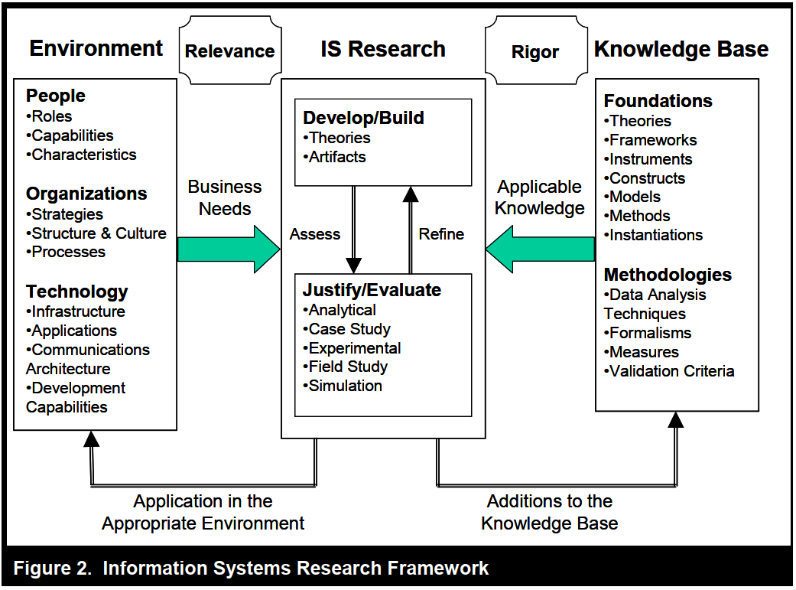
Alan Hevner‘s Synthesis
What is Design Science Research?
Taken from Hevner, A.R., et al., Design science in information systems research. MIS Q., 2004. 28(1): p. 75–105.

Slide 8
Hevner’s Guidelines for Design

Slide 9
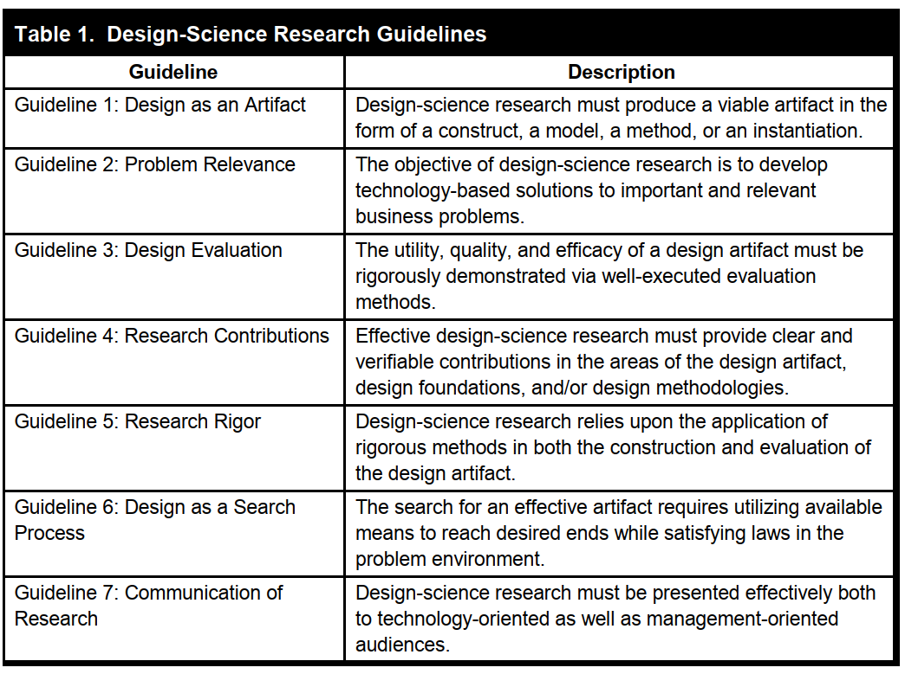
Overview
Hevner’s Guidelines for Design
Taken from Hevner, A.R., et al., Design science in information systems research. MIS Q., 2004. 28(1): p. 75–105.

Slide 10
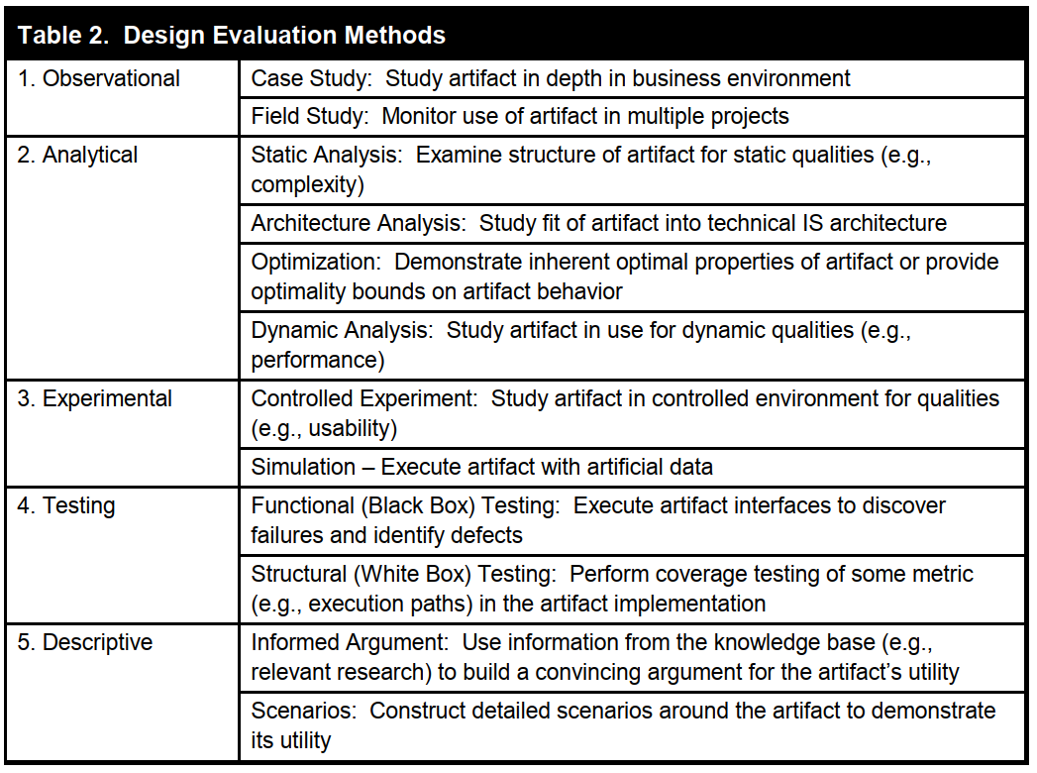
Guideline 3 – Design Evaluation
Hevner’s Guidelines for Design
Taken from Hevner, A.R., et al., Design science in information systems research. MIS Q., 2004. 28(1): p. 75–105.

Slide 11
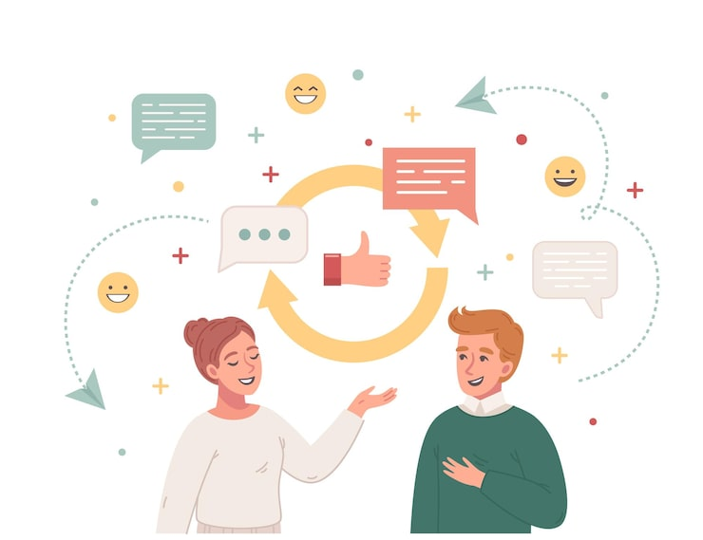
Guideline 7 – Communication of Research
Hevner’s Guidelines for Design
You have to be able to address both technically- and non-technically orientated people
DSR researchers have to bridge the communication gap between them
Technically-orientated people often are interested in
Details
Mechanisms of functionality
Construction plans
Proof of work
“Beauty”/Sophistication of the solution
Non-technically-orientated people (managers) are often interested in
Broad overviews
Resource consumption
Organizational impact
Problem relevance
Source: https://img.freepik.com/free-vector/communication-cartoon-design-concept-with-social-networks-signs-young-pare-talking-each-other-flat-vector-illustration_1284-80585.jpg?semt=ais_hybrid&w=740&q=80

Slide 12

Who fails to comunicate ofteh hits a Glas Wall
Hevner’s Guidelines for Design
Bad communication/Bad presentation does (usually) not lead to disapproving feedback, but to a fade out of communication
Who cannot communicate/present their ideas normally will not receive questions or feedback but ignorance
Many people later on hit a glas wall: „Why are my ideas not heard? Why is my performance not seen?“ – because they just cannot communicate
Image generated using Perplexity.AI Pro

Slide 13
Design Science Project Cycle

Slide 14
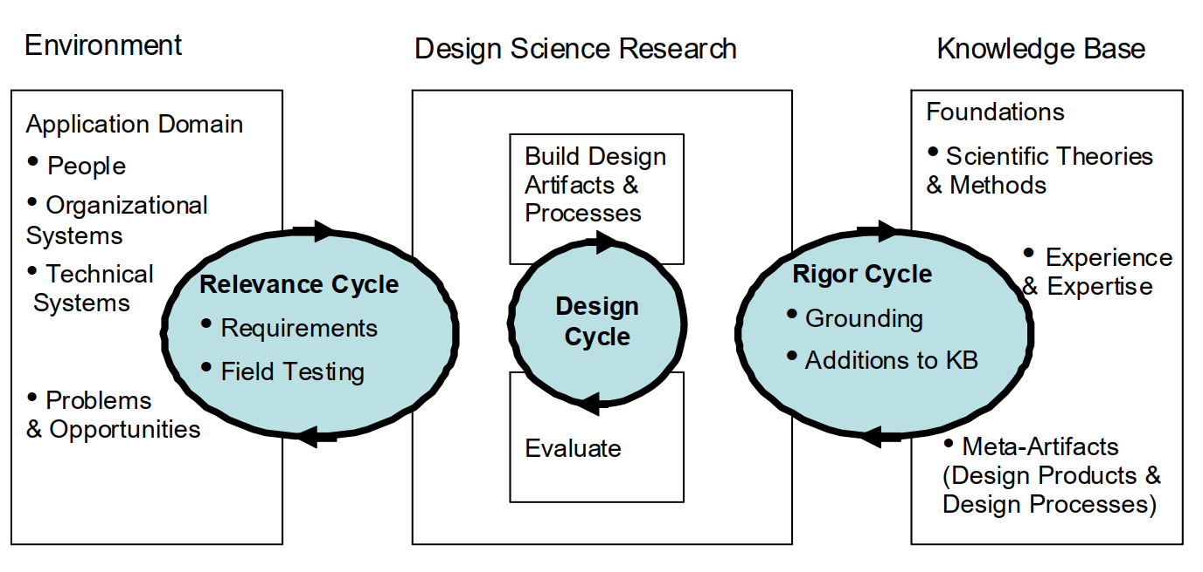
Three Cycles of Design Science
Design Science Project Cycle
Taken from Hevner, A., A Three Cycle View of Design Science Research. Scandinavian Journal of Information Systems, 2007. 19.

Slide 15
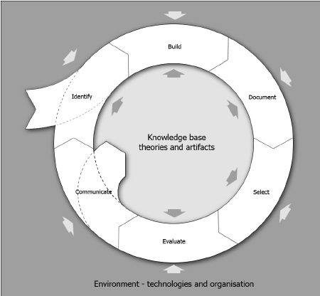
Design Project Cycle
Design Science Project Cycle
Taken from Brocke, J.v. and C. Buddendick, Reusable Conceptual Models-Requirements Based on the Design Science Research Paradigm, in DESRIST 2006. Claremont, CA.

Slide 16

Important Lessons for your Project
Design Science Project Cycle
Clearly determine your requirements – it is the customer who defines the requirement!
Invest time and effort to understand the problem and its environment.
Build your artifact iteratively
Evaluate your artifact against your requirements – not only against easy measurable KPIs
Document your findings and learnings not only your artifact

Slide 17
Thank you for your attention!

